Slide 1

TechGear Inc.
Sales & Marketing
Performance Analysis
Paul Medvidik

Slide 2
Executive Summary
Key Findings
Instagram advertising generated the highest modeled ROI
Discount strategies negatively impacted profitability
Predictive models indicate risk of missing monthly profitability targets
Regression models outperformed decision tree models in forecast accuracy
Strategic Recommendations
Increase Instagram advertising allocation
Reduce dependency on discounting
Use short-term exponential smoothing forecasts
Monitor profitability through predictive KPI dashboards

Slide 3
Data Exploration and Summary
Priority is given to Facebook advertising, spending $297.27 on average per month.
Instagram advertising spend averaged $92.53, approximately two-thirds lower than Facebook.
The median discount to customers is 12%, whereas the mean is 12.38%, exhibiting consistency and stability.
Facebook $297.27
Instagram
$92.53
Discount
12.38%

Slide 4
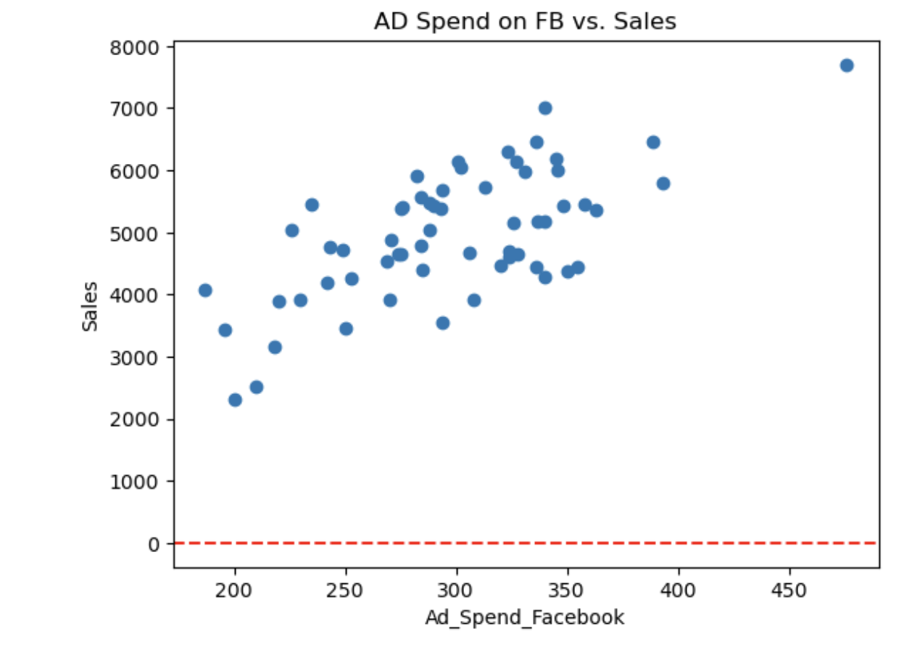
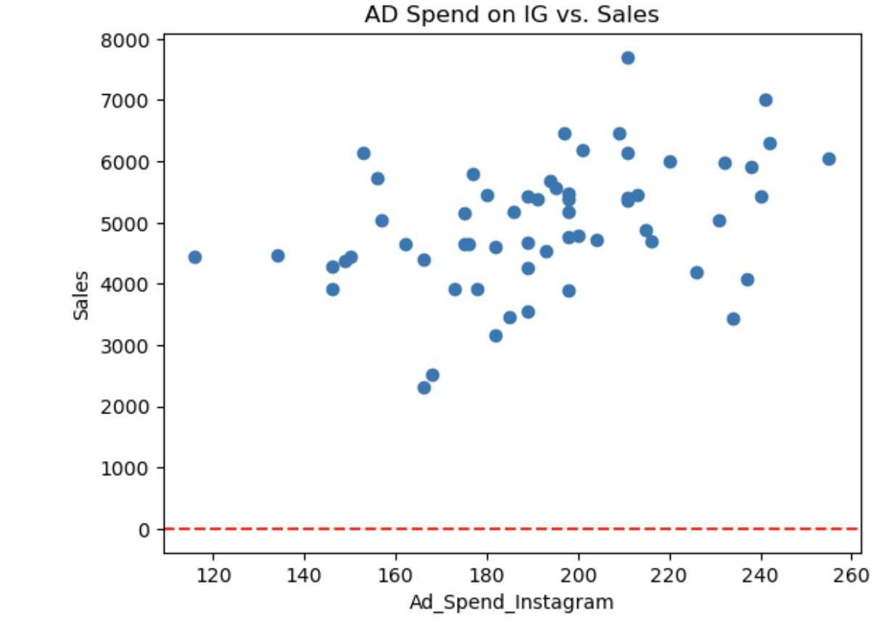
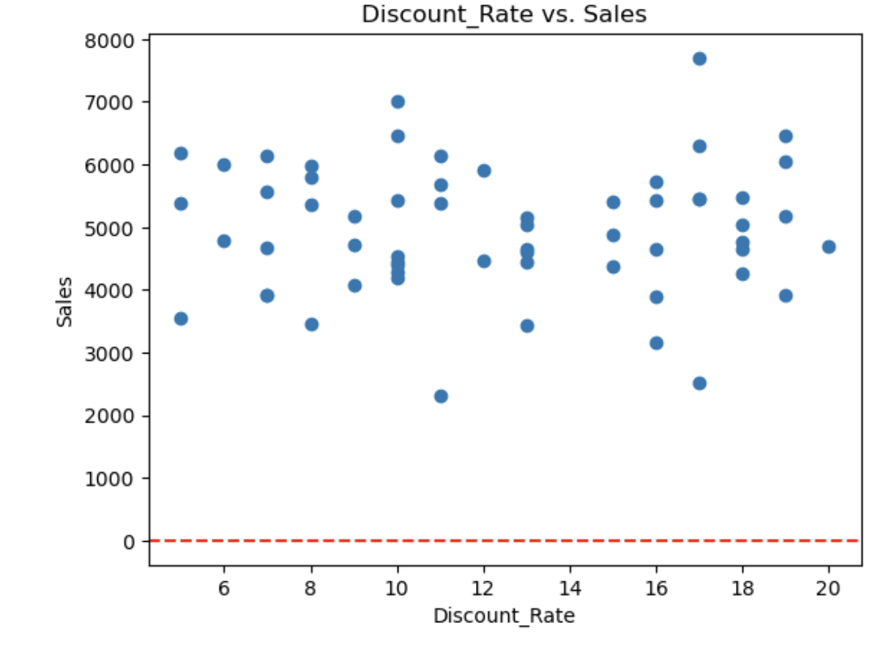
Visualizing Relationships
Facebook displays the strongest positive linear relationship to Sales.
Instagram shows a less consistent linear relationship. However, the data points reside at the same sales values as FB with less overall spending.
Discount rates demonstrated no significant direct relationship with sales performance.

Slide 5
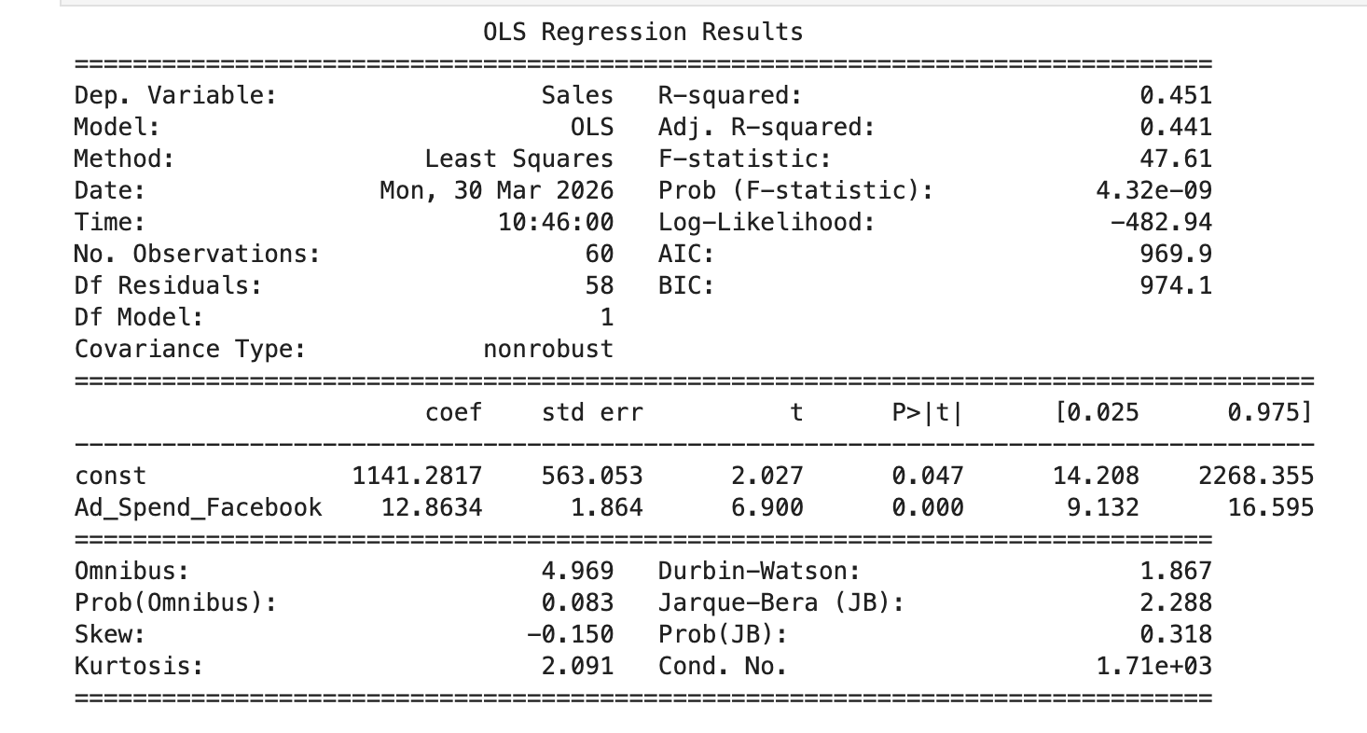
Regression Analysis
For every $1 spent on a FB ad, sales increase by $12.86.
P-value (.047) is showing a strong correlation, but this can be further refined.
R²-value:
45.1%
This is a moderate to low R²-value, further suggesting this is not a definitive model. There are missing variables that are distinct sales drivers.

Slide 6
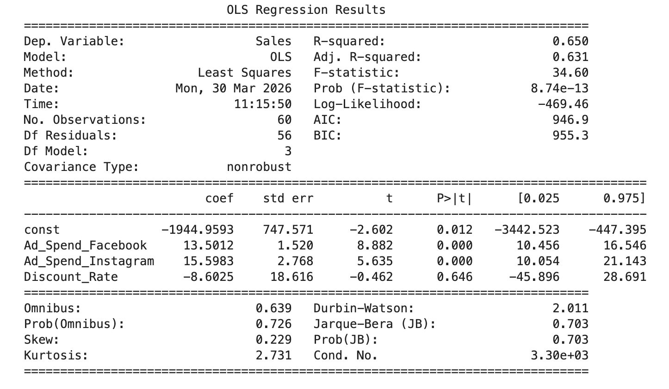
Multi-Factor Analysis
Coefficients Analysis:
R2 increased 45.1% to 65%
Facebook increased to 13.50
Instagram is 15.60
Discount Rate is -8.60
Instagram advertising demonstrated the strongest modeled ROI

Slide 7
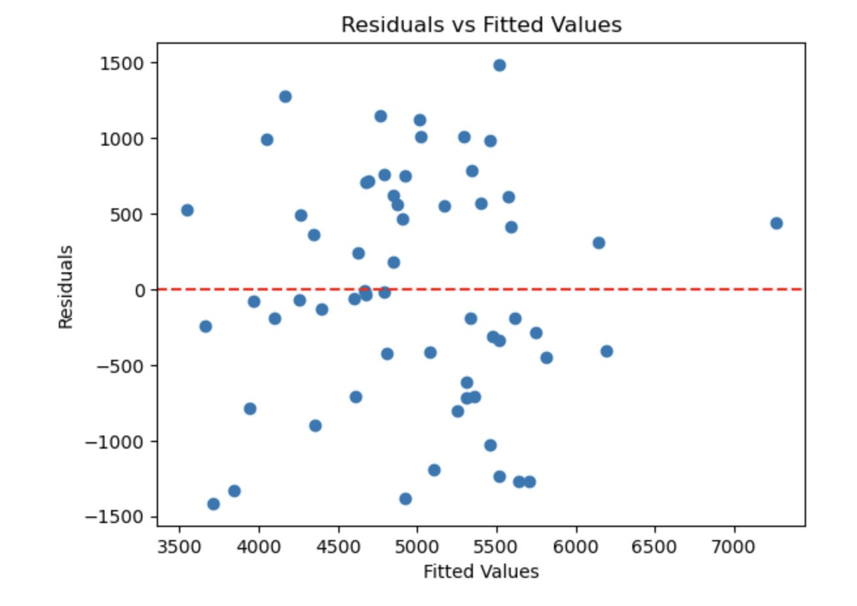
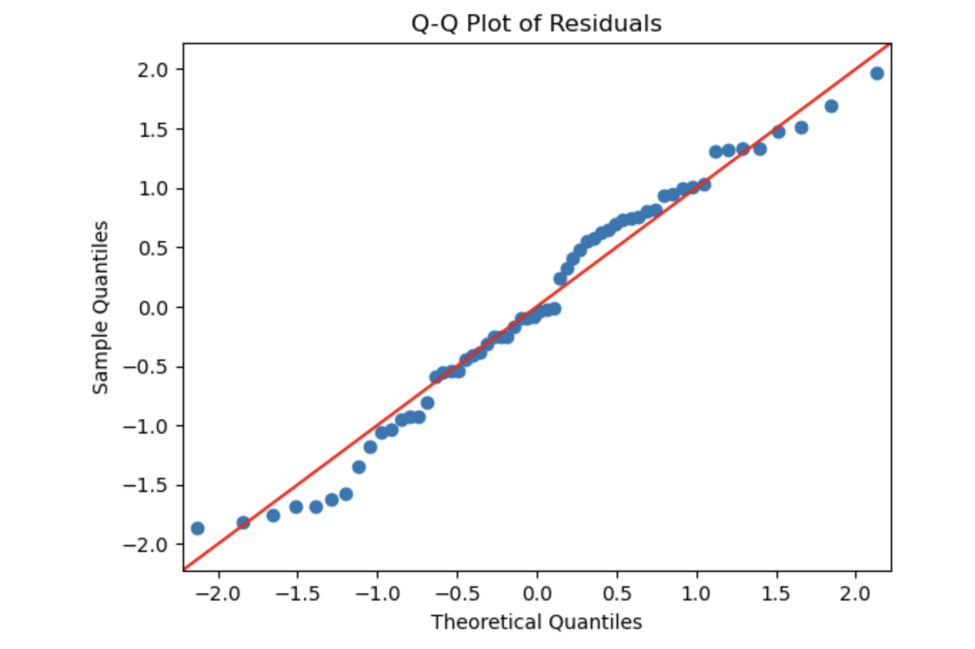
Forecasting Models
Residuals vs Fitted Values Plot
Model diagnostics indicate reliable predictability.
Q-Q PLOT
Consistency in the regression model is optimal!

Slide 8
Forecasting
Exponential Smoothing:
.80 Smoothing Factor
$6,032.01
Prioritize Instagram Ad Spend since it has the highest ROI and optimize discount strategy to minimize diminishing returns.
3 mo.
Moving Average:
$6,059.33
Use Exponential Smoothing and short term predictions to stay in-line with market trends and seasonality.

Slide 9
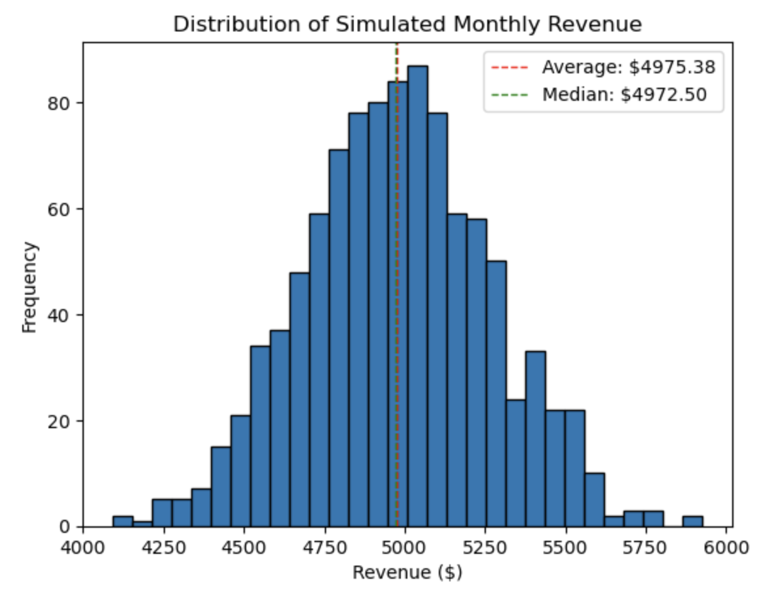
Monte Carlo Simulation
Estimated Average Monthly Revenue
= $4,975.38
Median
= $4,972.50
Standard Deviation
= $290.96
Profitable goal is $6,500/mo. TechGear has to encourage sales growth.
Plan staffing and marketing campaigns around expected sales.
Allocate more of the marketing budget to Instagram. This allows decreases in spending while still increasing sales.

Slide 10
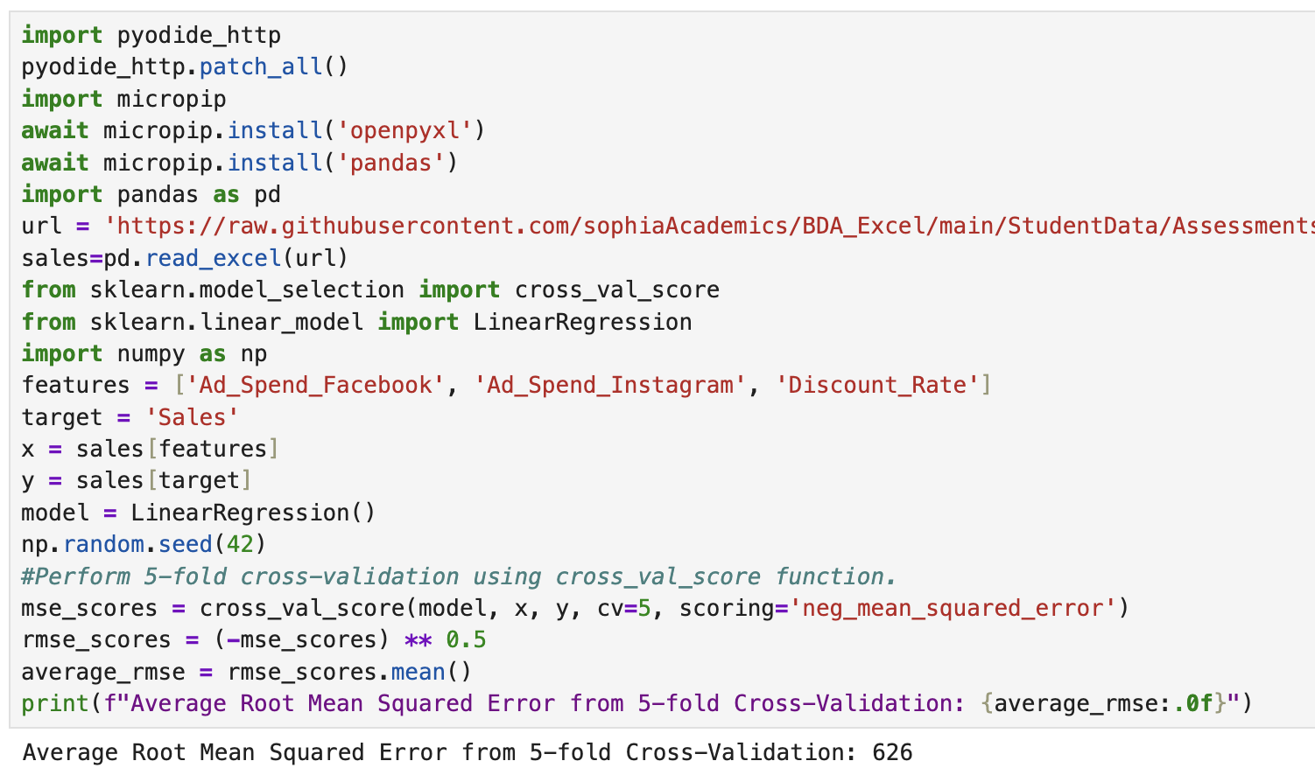
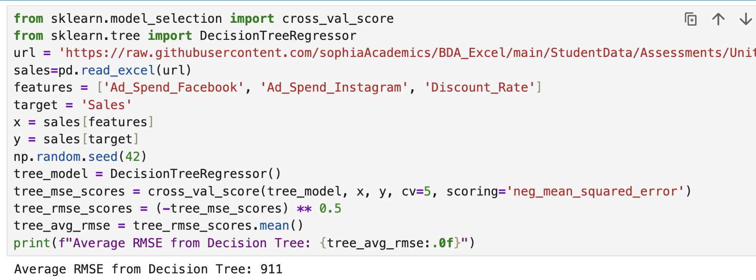
Predictive Model Performance
Regression Model
Decision Tree Model
RMSE = 626
RMSE = 911
If the sales prediction is $4,975, an RMSE of +/-626 establishes a range of $4,349-$5,601.
With a goal of $6,500 per month, the company is at risk of not being profitable.

Slide 11
Optimization
Maximum Annual Advertising Budget
$10,000
Optimal Budget Allocation
= 13.5F + 15.6I
Constraints:
I >= $5,000
$1,000 =< F <=$5,000
F = .5I
Facebook Spend
= $3,333.33
Instagram Spend
= $6,666.67
Maximum Annual Sales Revenue
= 13.5(3333.33) + 15.6(6666.67)
= $149,000.01

